Slide 1

Pathway Project:
Unlocking Paths to Progress

Slide 2
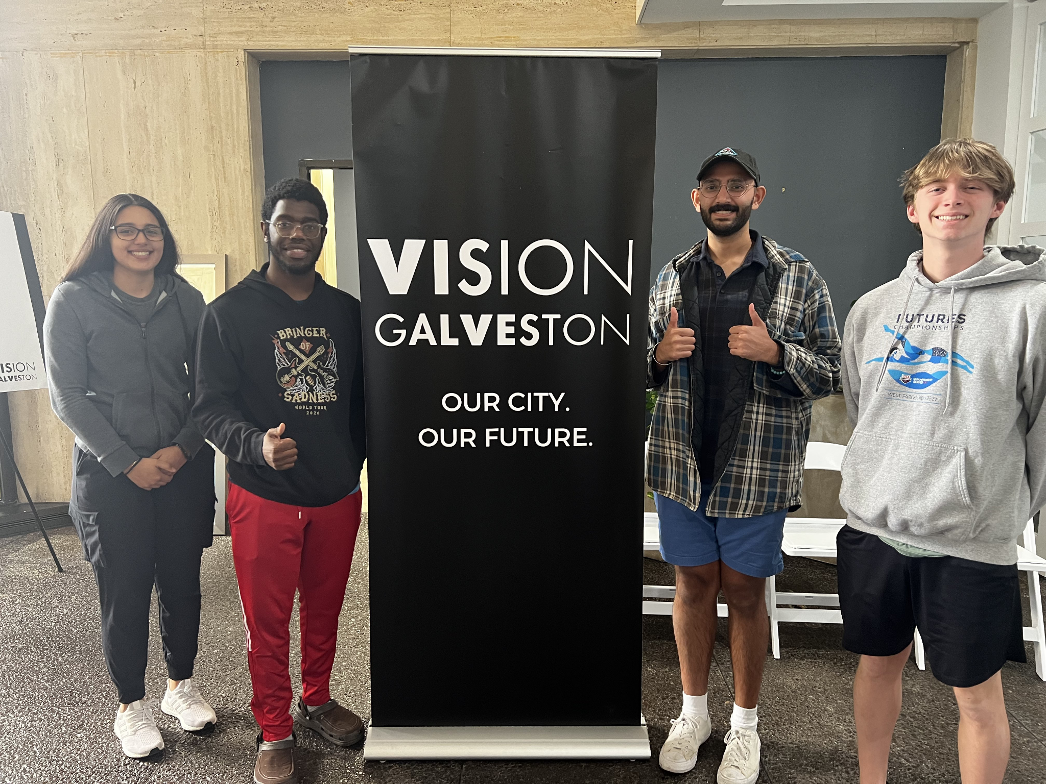
Team
John McQueen
Marine Engineering Student, TAMU Galveston
Gurjinder Toor
B.Sc Psychology - UH
Software Developer
Jackson Nace
Computer Science Student, UH
Kenia Benitez
Computer Science & Computer Engineering Student, UH
Notes:
But before we go further, we’d like to introduce the team first

Slide 3
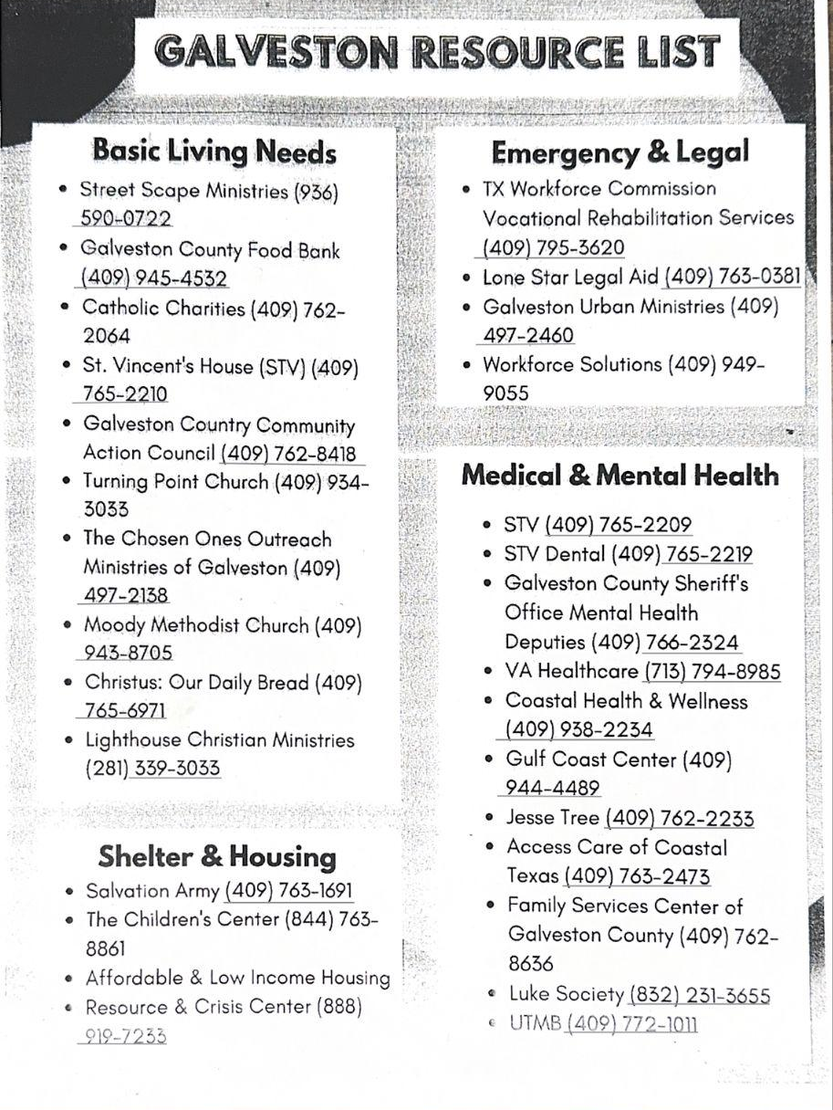
Problem
Material factors & circumstances impact mental health
Homelessness
Unemployment
Food insecurity
Substance abuse
Galveston has variety of necessary resources, but access inhibited and knowledge of resources limited
Notes:
Material factors and circumstances impact mental health - (1) homelessness (2) unemployment (3) food insecurity (4) substance abuse to name a few
One of the top reasons for not receiving care is accessibility
Galveston has a variety of necessary resources to assist all of these issues, but access is inhibited and knowledge of resources limited
Organizations provide a list of resources as the category, the organization, and a phone number, which presents obstacles and hard to navigate
~25 seconds
We visited the Rosenberg Library after being notified they provide an extensive list of resources - an immediate issue with the list provided is it only provides a list of [organization name] & [phone number] - getting a library card is free but it requires a state-issued ID and an application which if you do not have you’re able to access the computer lab at the 3rd floor and use their computers. Navigating through all the various resources and finding information becomes tedious and if you need directions to a location it becomes 10 cents per page - if you require directions to multiple resources this adds up thus leading people to utilize this resource less and leading to increasing lack of resource accessibility

Slide 4
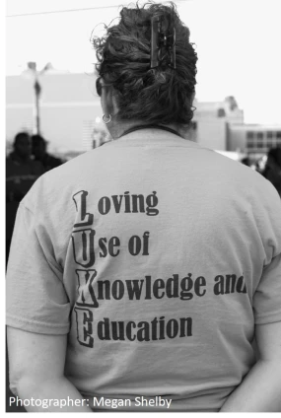
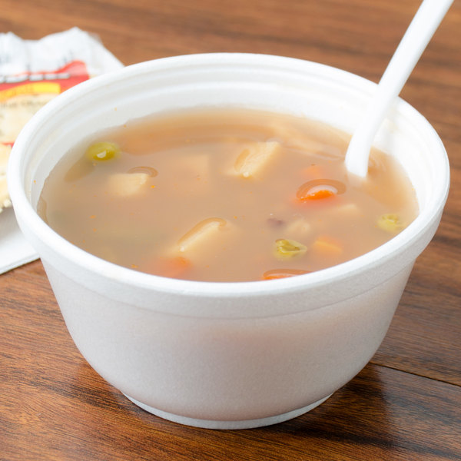
Well-Established Communities
Hobo Breakfast
The Luke Society Clinic
UTMB
Corre
Daily Bread
Various churches
Notes:
Well-established communities and organizations exist on the island, here a few to name
We actually went to Hobo Breakfast, it’s an event hosted every Saturday where organizations distribute resources, and were told up to 10 new homeless individuals visit each week requesting resources - but the list of resources provided is similar to the list on the previous slide
~25-30 seconds
We went to the Hobo Breakfast, an event hosted every Saturday from 8AM to 9AM that’s available to everyone. Individuals who are displaced and at risk often attend the event. Community organizers are at the event help individuals with medicine, food, clothing, etc.
We spoke to The Luke Society Clinic that offers a variety of medical assistance and have grants that specifically help with medical needs. They work with student volunteers from UTMB who we spoke to alongside The Luke Society and found the resources made available to individuals, however, the issue remains consistent, the print outs would often be of an [organization] and a [number].

Slide 5
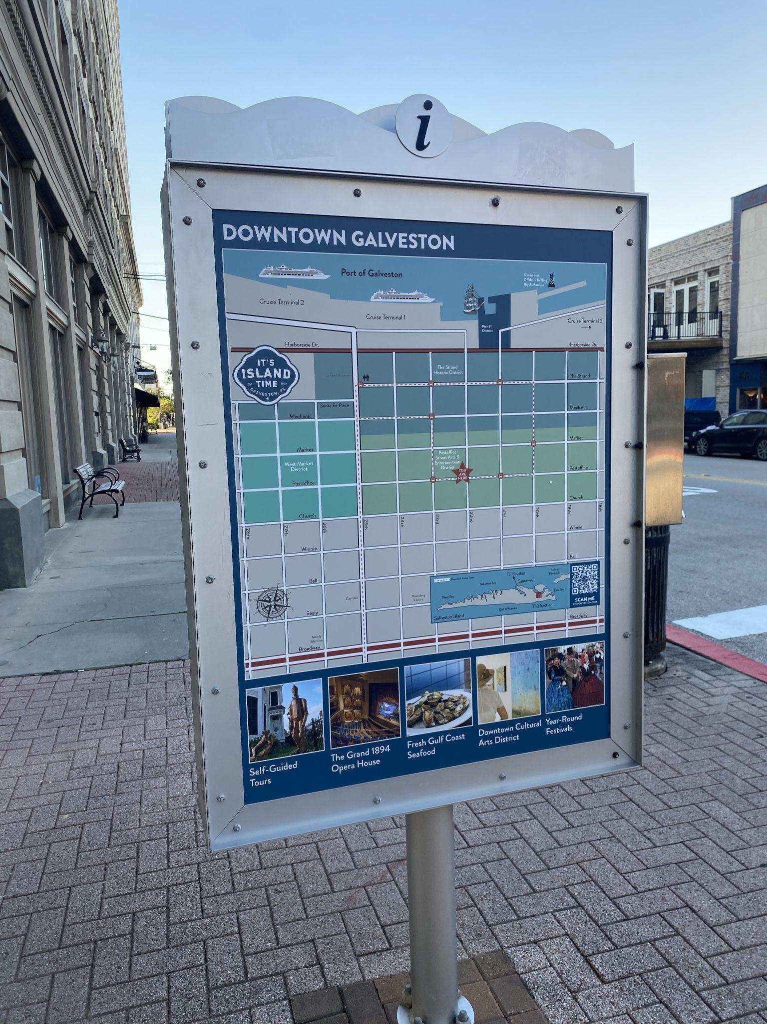
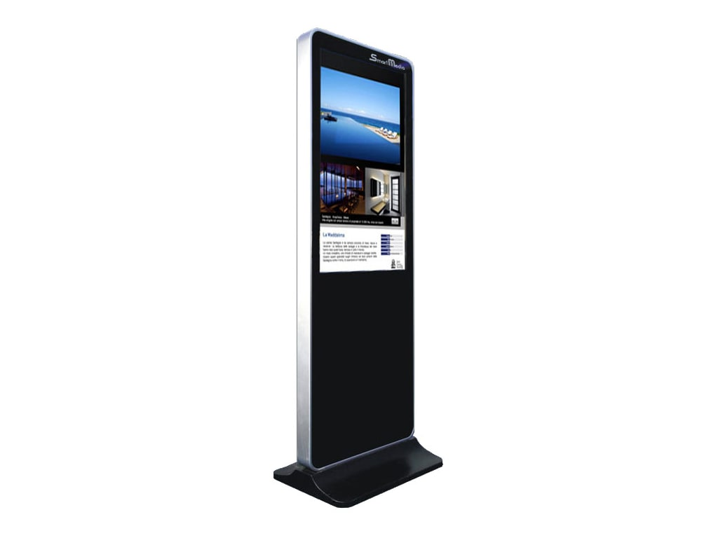

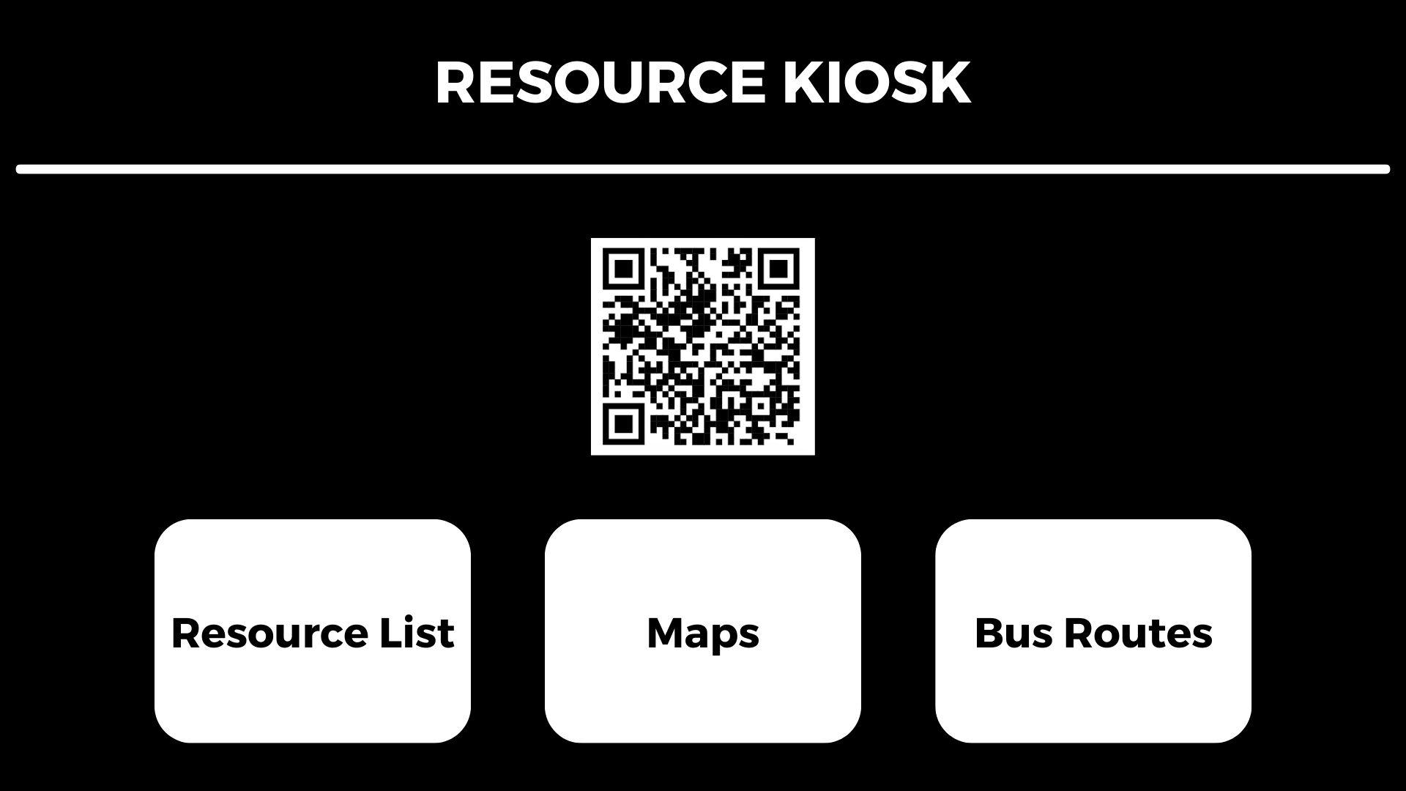
Resource Kiosk
Notes:
Kiosks provide information and awareness of resources as well as directions and local bus routes
Allows real-time updates of resource availability
Would provide analytics of which resources searched the most, provides insights of which resources to fund and which resources are lacking
Kiosks direct individuals to necessary organizations that assist and distribute resources, particularly important outside the scope of shelter and food - emergency & legal, medical & mental, etc. because those categories are a lot more broad and an understanding of where to get those resources becomes troublesome
Kiosks allow us to be up-to-date with resources available rather than outdated pamphlets that don’t get updated
Kiosks would allow us to acquire analytics - inputs let us know what resources are the most necessary - whether medical, food, shelters, etc. - data aggregation tells cities and organizers where they may lack in resources and what is more of a necessity for those displaced & at risk the most

Slide 6
Notes:
QR code to allow individuals with phones to access the website, website used to provide all resources at the kiosk
3 Key Focus Areas - (1) Resource List/Categories (2) Maps to view directions (3) Bus Routes
A study by the charity St Mungo’s Broadway in 2014, found that 51% of 139 homeless clients lacked basic skills in written English. In the general population, the percentage of people that would not achieve a grade 1 at GCSE is around 15%.
The Barbara Bush Foundation as of last year that 28% of Texas adults have lower than a 6th grade reading level - to quantify that it’s roughly around 6.5 million Texas adults.
Texas ranks 3rd amongst illiteracy rates for students —
According to _____ as of _____ 70% of elderly homeless individuals have access to a cell phone and 62% of homeless teens have a cell phone.

Slide 7
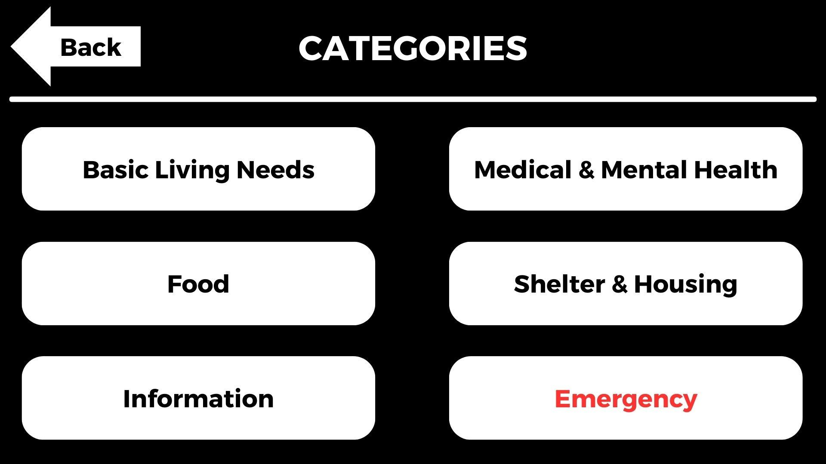
Notes:
Example categories for resources

Slide 8
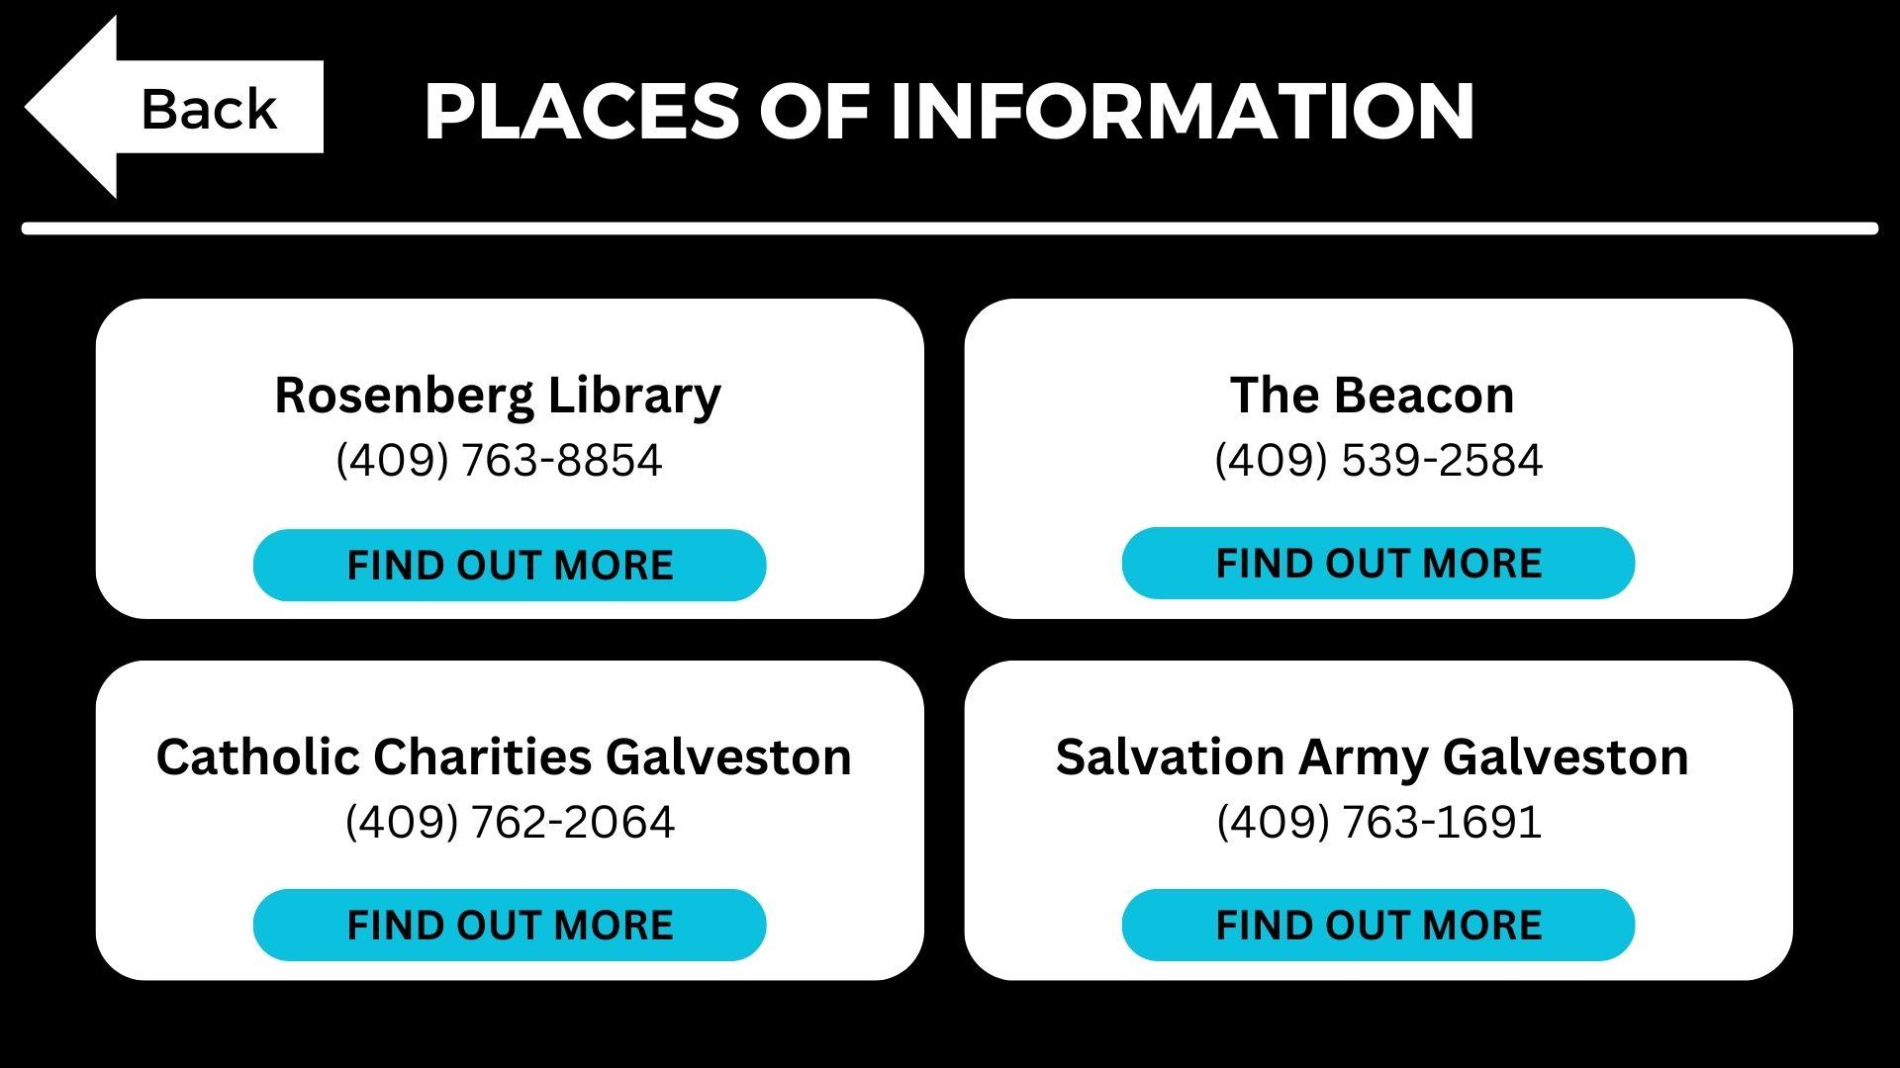

Slide 9
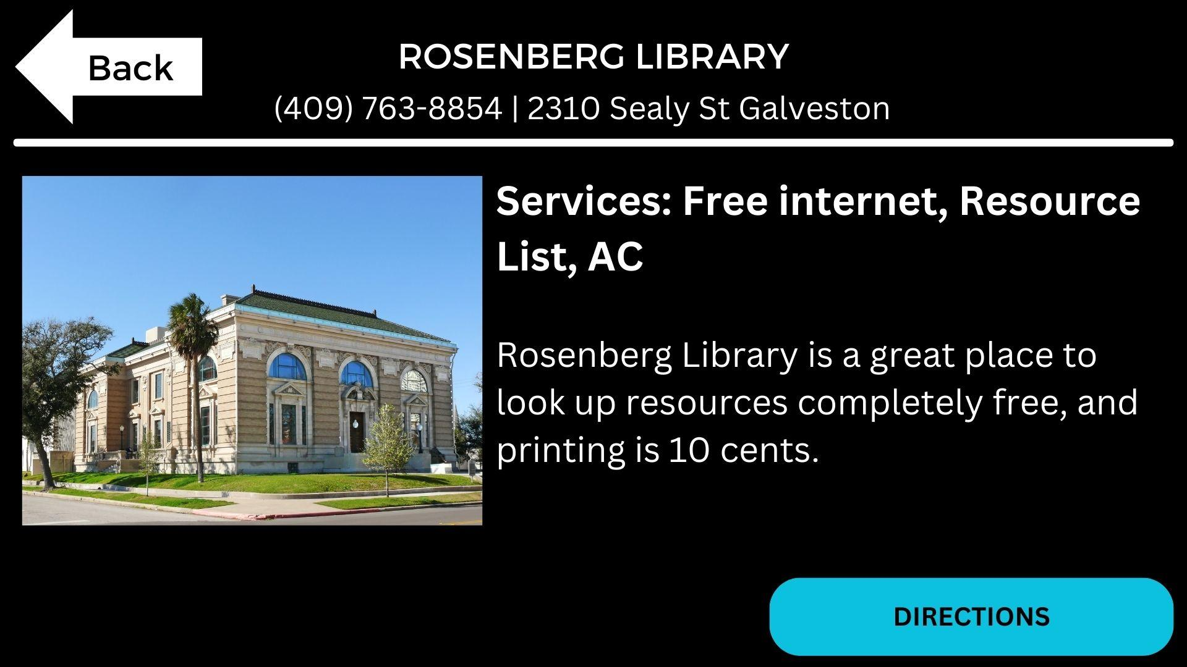
Notes:
Individual locations provide various pieces of information - (1) name (2) address (3) phone number (4) services (5) information (6) directions

Slide 10
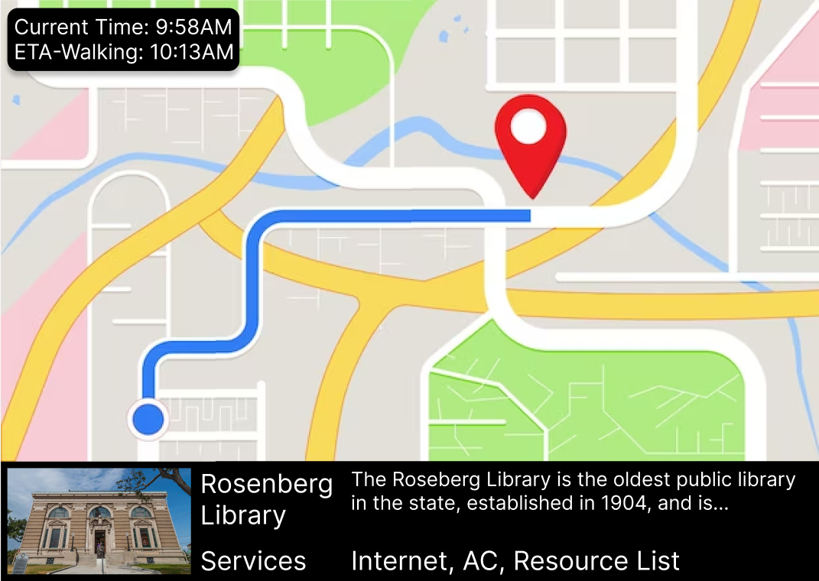

Slide 11
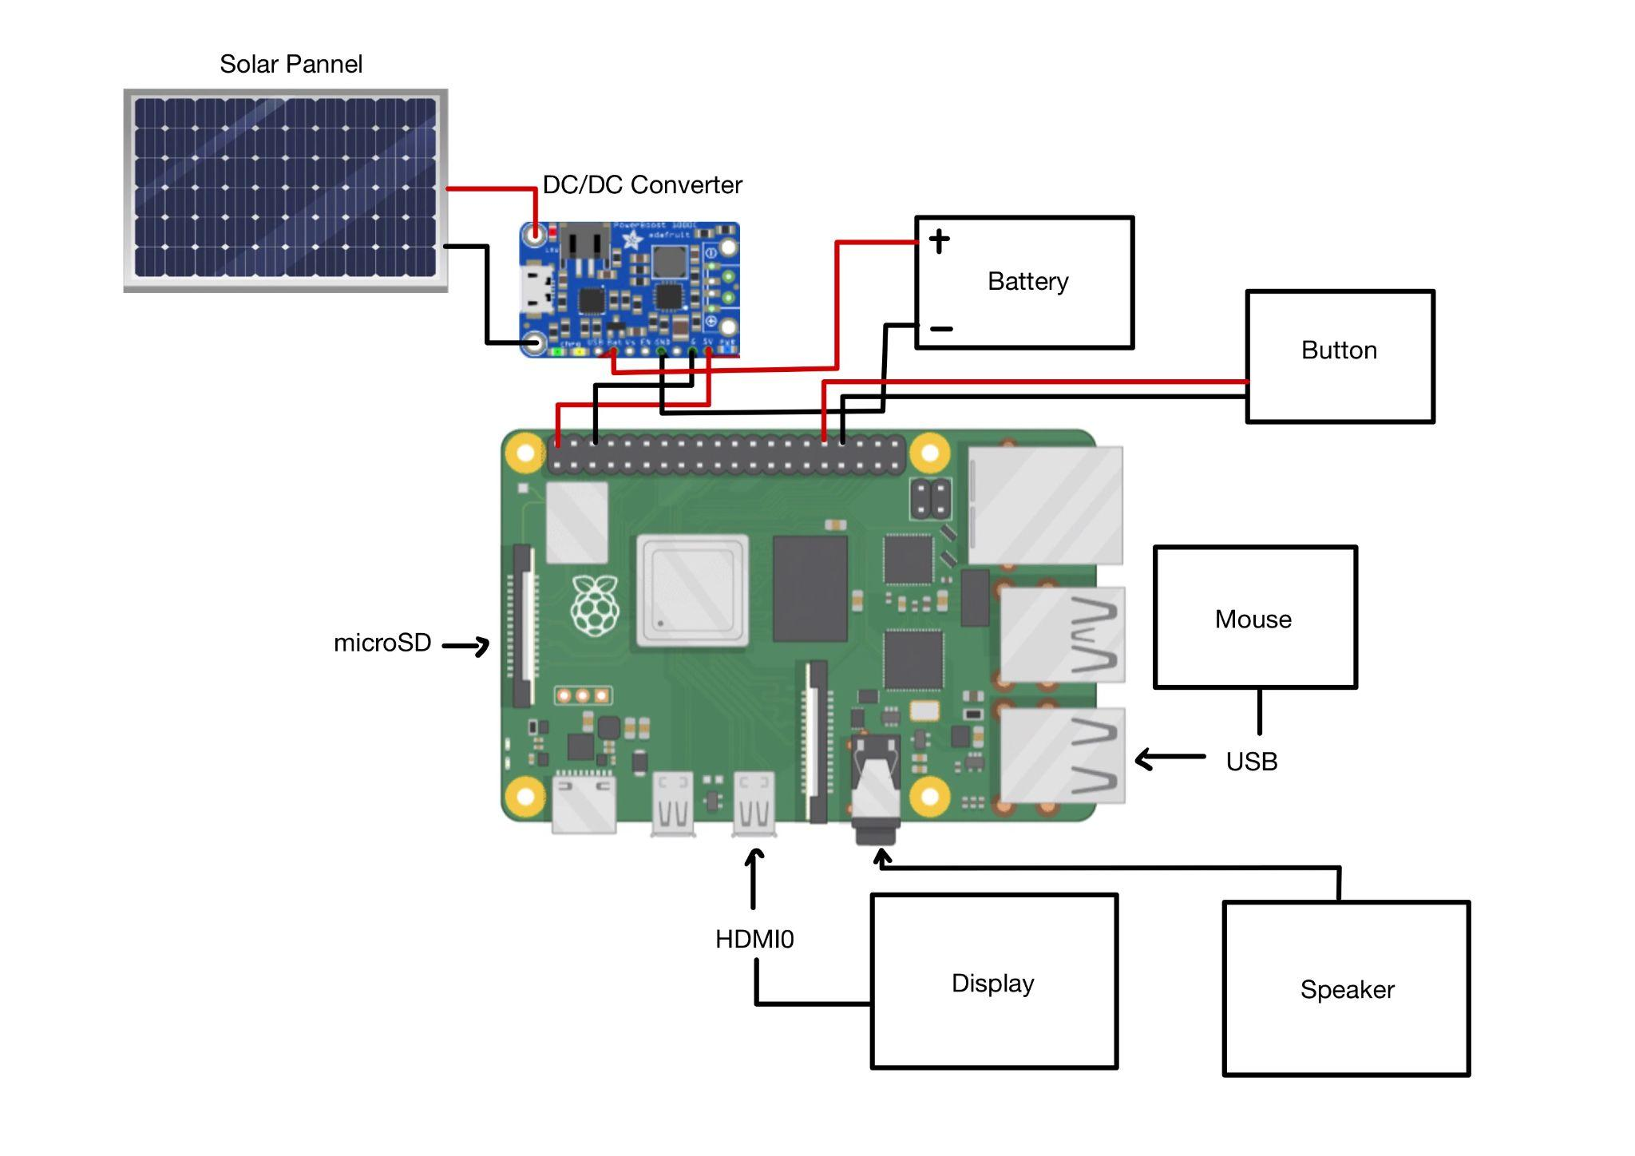
Prototype

Slide 12
Cost Breakdown
Item | Estimated Cost
Solar Panel | 269.00
Raspberry Pi 4 | 55.95
Battery | 39.99
Display | 100.00
Mouse | 54.99
Button | 9.95
DC/DC Converter | 9.95
Speaker | 29.95
Total Approx (prototype):
$600.00

Slide 13


Grants / Funding
Permanent Endowment Fund of Moody Memorial - able to provide grants from $50k - $250k annually
Mary Moody Northen Endowment - up to $20k in grants
Notes:
https://www.pefgalveston.org/apply

Slide 14
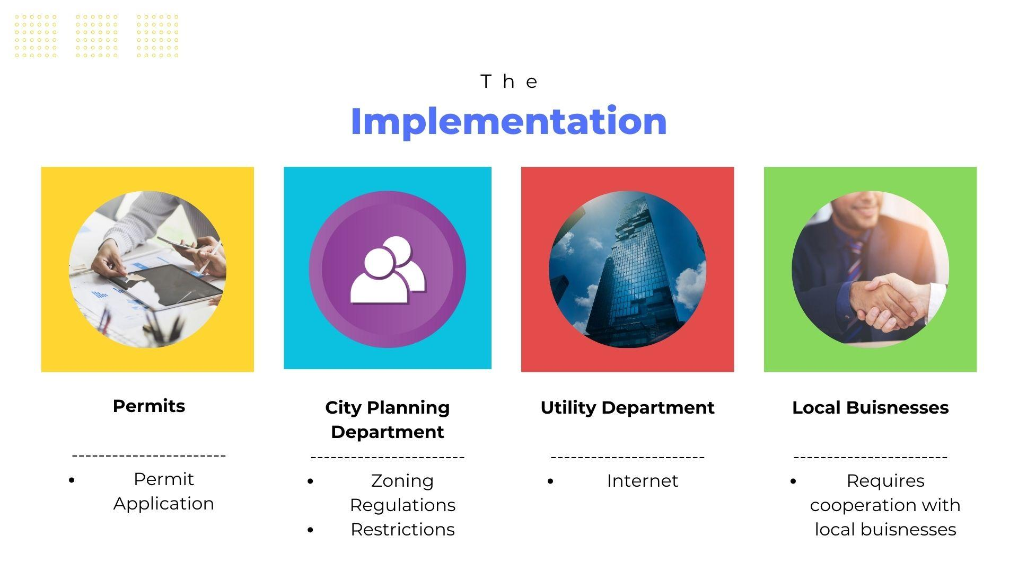
Notes:
For implementation we’d have to contact certain offices - (1) Permits Office for permit applications (2) City Planning Department for zoning and regulations (3) Utility Department for kiosks to access the internet (4) Local Businesses for cooperation and partnerships
~15-20 seconds

